Slide 1

THE IMPACT OF EMERGING CLOUD SECURITY THREATS: A FOCUS ON ADVANCED PERSISTENT THREATS
Name: Austin Orumwense
Student ID: 2214630
Academic Supervisor: Dr. Mansoor ihsan
Date: September 15, 2023

Slide 2
Outline
Introduction
Aim and Objectives
Methodology
APT29 Emulation
Results
Conclusion

Slide 3
introduction
Advanced persistent threats (APT) represent a rapidly expanding threat in the field of information security, posing significant challenges for organizations. These attacks are orchestrated by highly skilled and well-resourced attackers (Singh et al., 2019).
Advanced Persistent Threats represent a category of sophisticated cyberattacks intended to execute intelligent and highly impactful assaults with the goal of evading detection by leveraging extensive reconnaissance activities (Halabi et al., 2022)
Detecting APT hacks involves recognizing distinct indicators since these hackers employ different techniques compared to typical hackers (Rouse, 2020).

Slide 4
APT Lifecycle
Reconnaissance
Establish foothold
Lateral movement
Exfilteration/Impediment
Post Exfiltration
The main objective of APTs is to exfiltrate data to external hosts, involving activities such as data theft and data exfiltration (Quadri and Khan, 2019).

Slide 5
Research Aim AND OBJECTIVES
This research aims to identify and evaluate the impact of APT in cloud environments and proffer efficient mitigation strategies.
The specific objectives of this study are listed below:
Investigate the impact of Advanced Persistent Threats on cloud security.
Analyse the strengths and weaknesses of the current approaches for addressing APT in cloud environments.
Design an operation to emulate an APT adversary plan.
Simulate APT attacks using Mitre Caldera and assess detection capabilities using Snort.
Utilise the Nessus Vulnerability scanning tool to identify potential vulnerabilities that can be exploited by APT.
Provide recommendations for improving security in cloud environments based on research findings.

Slide 6
Methodology
Setup and Configuration
Provision two AWS EC2 instances: Linux and Windows.
Install Caldera and Nessus on the Linux instance.
Install Snort on the Windows instance.
Attack Scenario Preparation
Configure Caldera to perform APT 29 emulation attacks on the Windows instance
Attack Simulation
Initiate APT 29 emulation attacks from Caldera to the Windows instance.
Monitor and record the attack activities and techniques used.
Detection and Analysis
Monitor the Windows instance using Snort to detect APT 29 techniques.
Record Snort alerts and logs for analysis.
Vulnerability Scanning
Execute Nessus scans on the Victim instance to identify potential vulnerabilities.
Data Collection and Analysis
Analyse the impact of APT 29 attacks on the cloud environment.
Evaluate Snort's effectiveness in detecting APT techniques.
Assess vulnerabilities identified by Nessus.
Conclusion and Recommendation
Summarize the findings from the attack simulations, detection, and vulnerability scanning.
Discuss the implications of APT attacks on cloud environments.

Slide 7
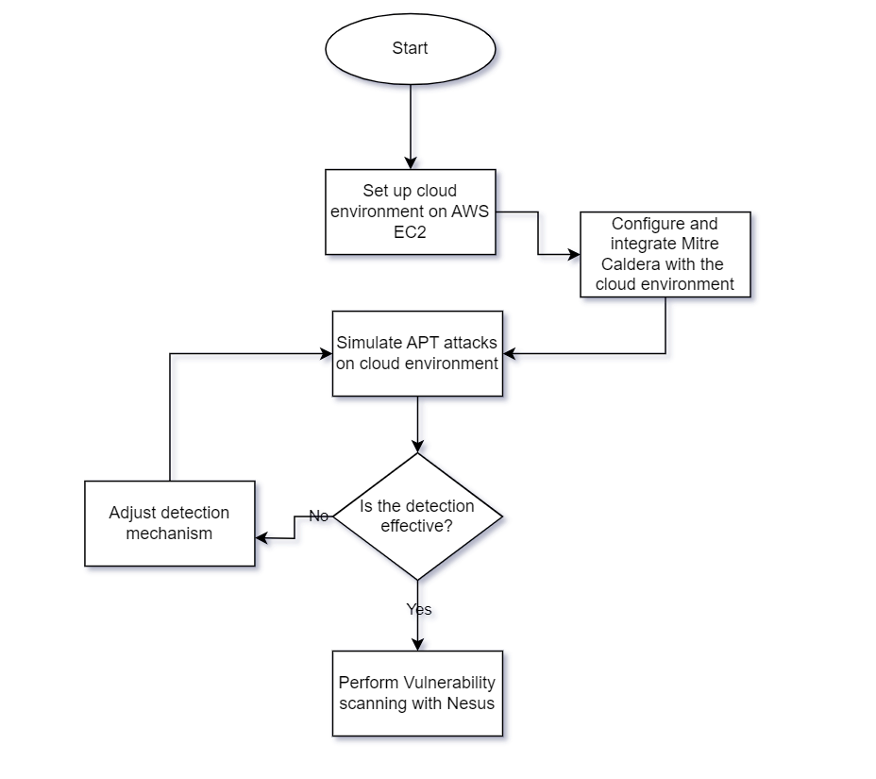
implementation

Slide 8
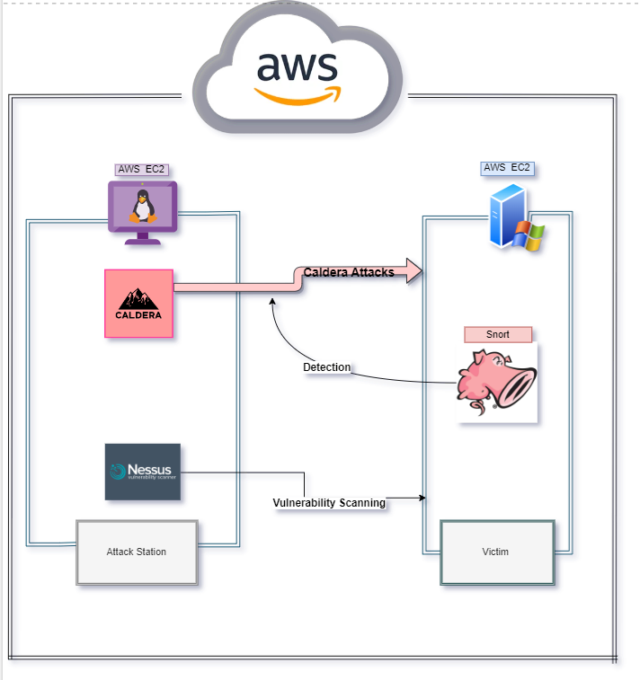
Simulation of the Experiment
Components
AWS EC2 Instances
Mitre Caldera
Snort
Nessus

Slide 9
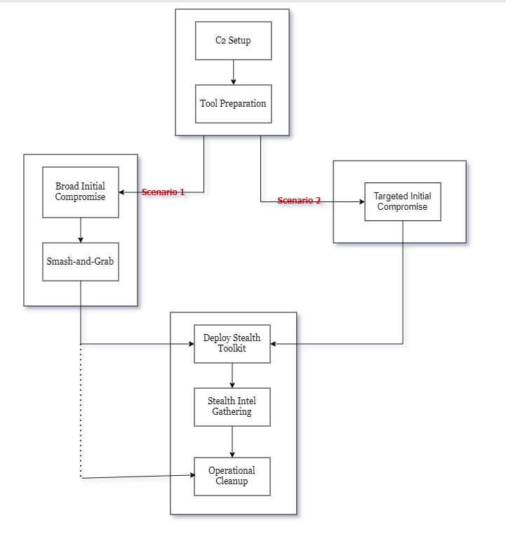
APT29 Emulation Plan
Scenario 1: In this approach, APT29 adopts a "smash-and-grab" tactic for collection and exfiltration of data.
Scenario 2: Here, APT29 employs a "low and slow" strategy to compromise a specific target through spear phishing.

Slide 10
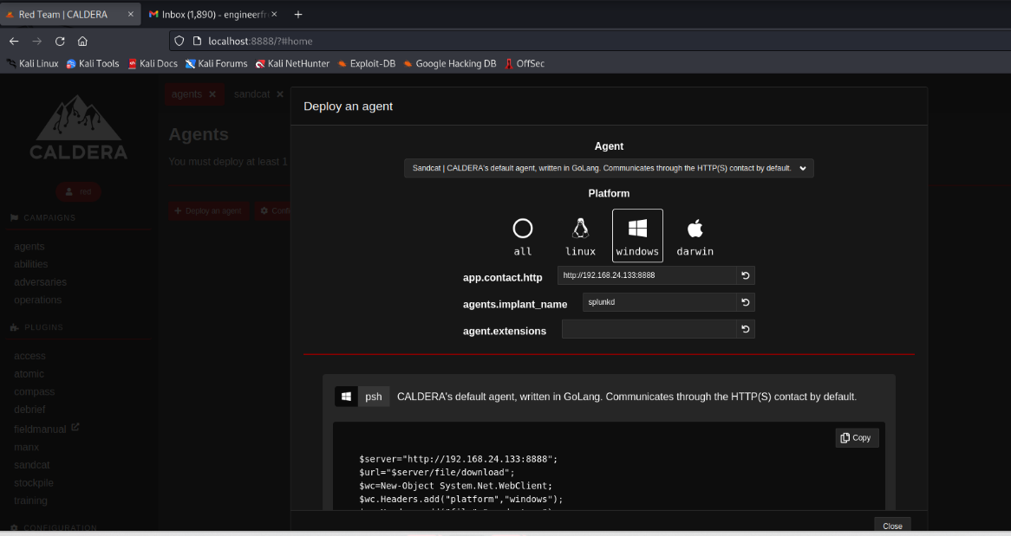
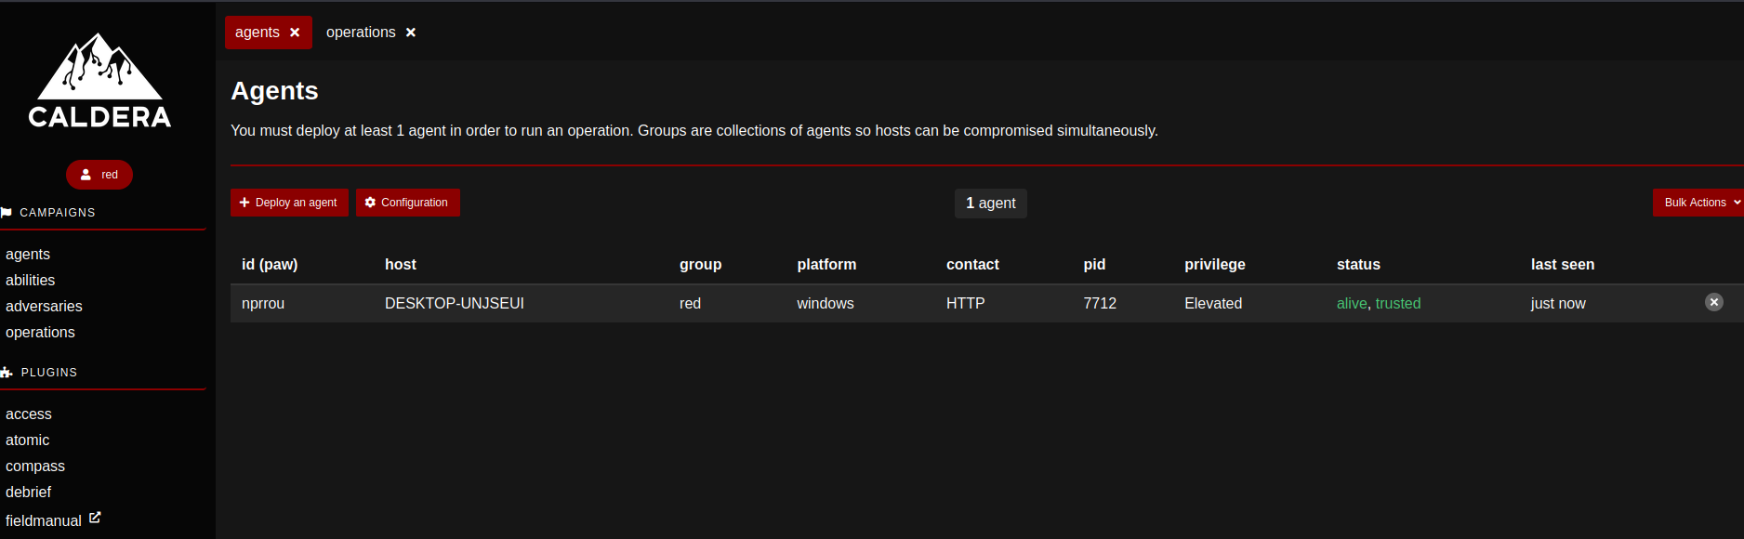
Establishing command and control
Deploying Agents
C2 Established

Slide 11
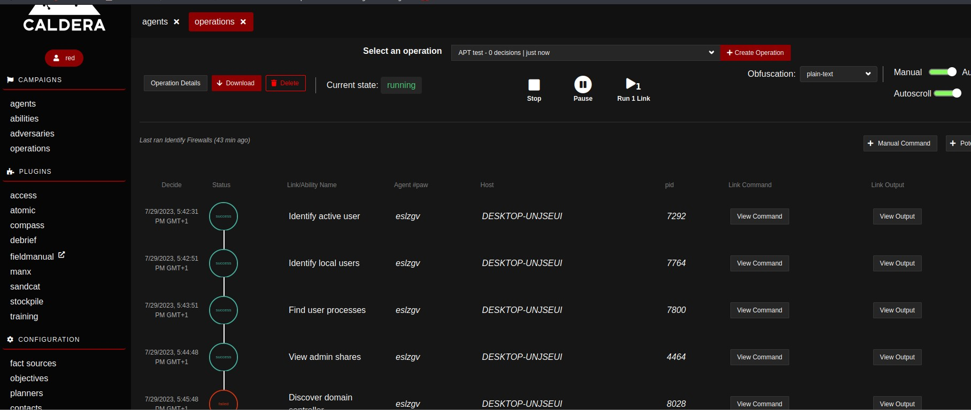
Running apt29 operation

Slide 12
results successful and failed techniques from Caldera

Slide 13
Facts found during operation

Slide 14
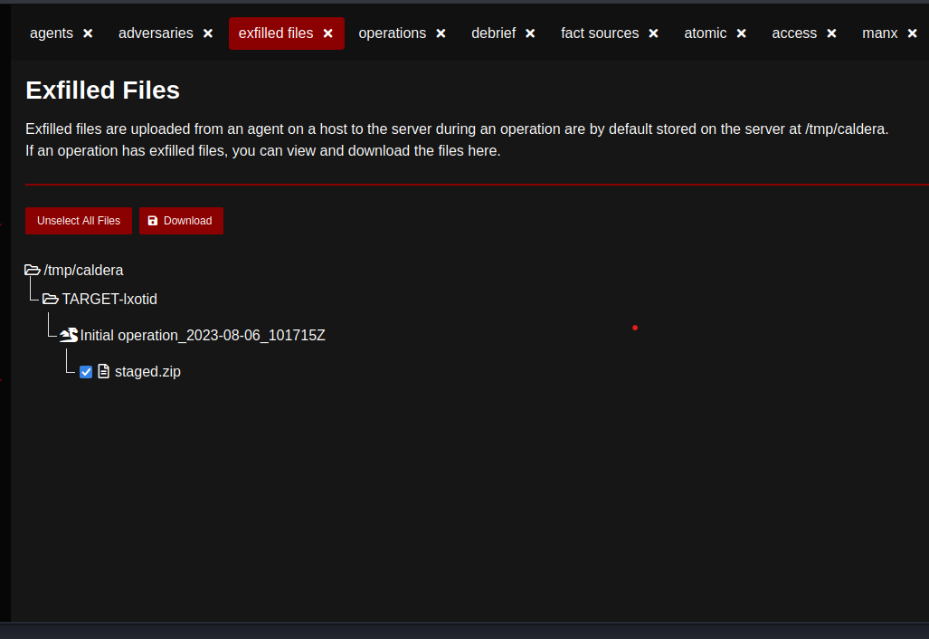
Exfiltrated files

Slide 15
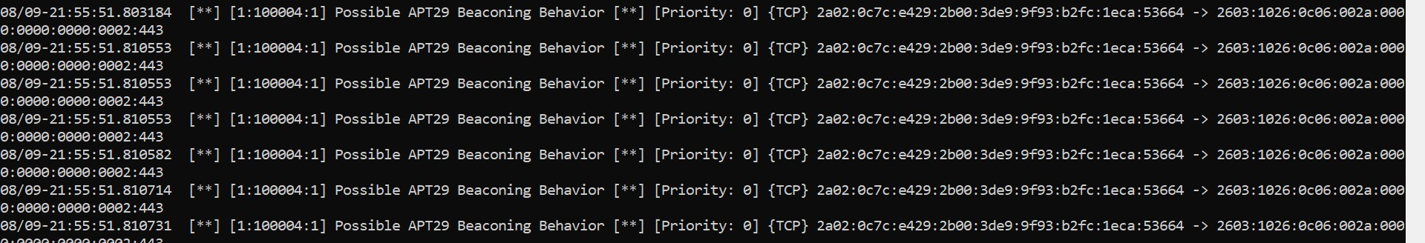
Snort Detection

Slide 16
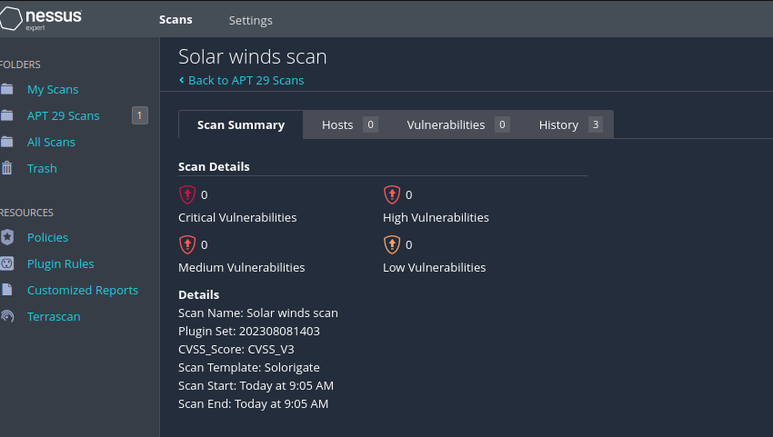
Vulnerability Scan
Basic scan
Solar winds scan

Slide 17
CONCLUSION
The collective findings of this research underscore the intricate interplay between APT activities and cloud environments, highlighting the critical need for robust detection and mitigation strategies. The synthesis of APT simulation, vulnerability assessment, and analysis of detection measures has yielded valuable insights into the evolving threat landscape within cloud ecosystems.
With regards to the research question “What is the impact of a successful Advanced persistent threat attack on cloud environment?” This thesis has demonstrated the severity of a successful APT attack and its impact on cloud environment using Caldera and its Emu plans.

Slide 18
Future Works
Behavioural Analytics and Machine Learning Integration: One potential direction for future exploration involves delving into the integration of advanced behavioural analytics and cutting-edge machine learning algorithms.
Dynamic Sharing of Threat Intelligence: A promising realm ripe for future investigation entails the establishment of dynamic platforms for the sharing of threat intelligence.
Advancement of Automated Incident Response Frameworks: The evolution of automated incident response frameworks stands as a pertinent area worthy of future exploration.

Slide 19
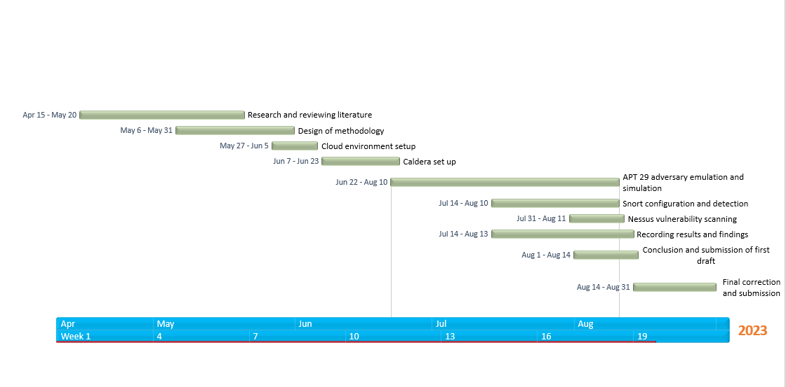
Project Timeline

Slide 20
References
Halabi, T. Wahab, O. A., R. Al Mallah, and M. Zulkernine. (2021) Protecting the Internet of Vehicles Against Advanced Persistent Threats: A Bayesian Stackelberg Game. IEEE Transactions on Reliability 70(3), 970.
Quadri, A., & Khan, M. K. (2019). Cybersecurity Challenges of the Kingdom of Saudi Arabia.
Rouse, M (2020). Advanced Persistent Threat (APT). Tech Target. [Online] Available from https://searchsecurity.techtarget.com/definition/advanced-persistent-threat-APT Accessed [28 May, 2023]
Singh, A. K., Koshy, A. S., & Gupta, M. (2023). Cloud Computing for Machine Learning and Cognitive Application. In Cloud-based Intelligent Informative Engineering for Society 5.0 (pp. 107-121). Chapman and Hall/CRC.

Slide 21

THANK YOU!!!

